Slide 1
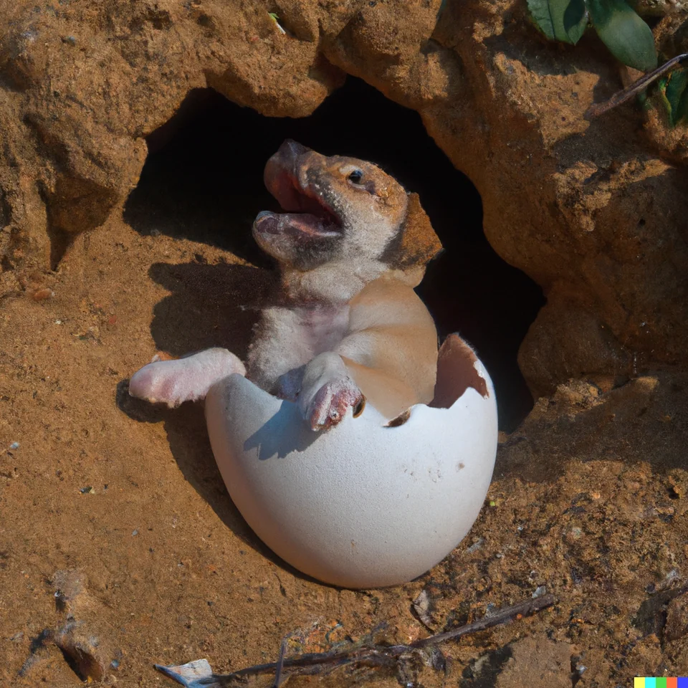
Defining and Using Classes
Lecture 2
CS61B, Spring 2024 @ UC Berkeley
Slides credit: Josh Hug
Notes:
Image from: https://www.reddit.com/r/dalle2/comments/xmfc4l/a_dog_hatching_from_its_egg/

Slide 2
Defining and Instantiating Classes
Classes in Java
Defining and Instantiating Classes
Class Terminology
Static vs. Instance Members
Practice Question
Interactive Debugging
Goal: Larger Than Four Neighbors
Using the Debugger
Lecture 2, CS61B, Spring 2024

Slide 3
Coding Demo: Dog class
Dog.java
public class Dog {
public static void makeNoise() {
System.out.println("Bark!");
}
}
Error: Main method not found in class Dog

Slide 4
Coding Demo: Dog class
Dog.java
public class Dog {
public static void makeNoise() {
System.out.println("Bark!");
}
public static void main(String[] args) {
makeNoise();
}
}
Bark!

Slide 5
Coding Demo: Dog class
Dog.java
DogLauncher.java
public class Dog {
public static void makeNoise() {
System.out.println("Bark!");
}
public static void main(String[] args) {
makeNoise();
}
}
public class DogLauncher {
}
Bark!

Slide 6
Coding Demo: Dog class
Dog.java
DogLauncher.java
public class Dog {
public static void makeNoise() {
System.out.println("Bark!");
}
}
public class DogLauncher {
public static void main(String[] args) {
Dog.makeNoise();
}
}
Bark!

Slide 7
Dog
As we saw last time:
Every method (a.k.a. function) is associated with some class.
To run a class, we must define a main method.
Not all classes have a main method!
Unlike python, there’s no need to import if the two files are in the same project.
public class Dog {
public static void makeNoise() {
System.out.println("Bark!");
}
}
Can’t be run directly, since there is no main method.
public class DogLauncher {
public static void main(String[] args) {
Dog.makeNoise();
}
}
Calls a method from another class. Can think of this as a class that tests out the Dog class.

Slide 8


Object Instantiation
Not all dogs are equal!
Notes:
12m30s without announcements or questions

Slide 9
A Not So Good Approach
We could create a separate class for every single dog out there, but this is going to get redundant in a hurry.
public class MayaTheDog {
public static void makeNoise() {
System.out.println("aroooooooooo!");
}
}
public class YapsterTheDog {
public static void makeNoise() {
System.out.println("awawawwwawwa awawaw");
}
}

Slide 10
Object Instantiation
Classes can contain not just functions (a.k.a. methods), but also data.
For example, we might add a size variable to each Dog.
Classes can be instantiated as objects.
We’ll create a single Dog class, and then create instances of this Dog.
The class provides a blueprint that all Dog objects will follow.
For the example above, all Dog objects will have a size.
Let’s try this out.
These instances are also called ‘objects’

Slide 11
Coding Demo: Dog class
Dog.java
DogLauncher.java
public class Dog {
public static void makeNoise() {
System.out.println("Bark!");
}
}
public class DogLauncher {
public static void main(String[] args) {
Dog.makeNoise();
}
}

Slide 12
Coding Demo: Dog class
Dog.java
DogLauncher.java
public class Dog {
int weightInPounds;
public static void makeNoise() {
System.out.println("Bark!");
}
}
public class DogLauncher {
public static void main(String[] args) {
Dog.makeNoise();
}
}

Slide 13
Coding Demo: Dog class
Dog.java
DogLauncher.java
public class Dog {
int weightInPounds;
public static void makeNoise() {
if (weightInPounds < 10) {
System.out.println("yip!");
} else if (weightInPounds < 30) {
System.out.println("bark.");
} else {
System.out.println("woooooof!");
}
}
}
public class DogLauncher {
public static void main(String[] args) {
Dog.makeNoise();
}
}
Error: Non-static variable weightInPounds cannot be referenced from a static context.

Slide 14
Coding Demo: Dog class
Dog.java
DogLauncher.java
public class Dog {
int weightInPounds;
public void makeNoise() {
if (weightInPounds < 10) {
System.out.println("yip!");
} else if (weightInPounds < 30) {
System.out.println("bark.");
} else {
System.out.println("woooooof!");
}
}
}
public class DogLauncher {
public static void main(String[] args) {
Dog.makeNoise();
}
}
Error: Non-static method makeNoise cannot be referenced from a static context.

Slide 15
Coding Demo: Dog class
Dog.java
DogLauncher.java
public class Dog {
int weightInPounds;
public void makeNoise() {
if (weightInPounds < 10) {
System.out.println("yip!");
} else if (weightInPounds < 30) {
System.out.println("bark.");
} else {
System.out.println("woooooof!");
}
}
}
public class DogLauncher {
public static void main(String[] args) {
Dog d = new Dog();
d.weightInPounds = 25;
d.makeNoise();
}
}
bark.

Slide 16
Coding Demo: Dog class
Dog.java
DogLauncher.java
public class Dog {
int weightInPounds;
public void makeNoise() {
if (weightInPounds < 10) {
System.out.println("yip!");
} else if (weightInPounds < 30) {
System.out.println("bark.");
} else {
System.out.println("woooooof!");
}
}
}
public class DogLauncher {
public static void main(String[] args) {
Dog d = new Dog();
d.weightInPounds = 51;
d.makeNoise();
}
}
woooooof!

Slide 17
Coding Demo: Dog class
Dog.java
DogLauncher.java
public class Dog {
int weightInPounds;
public Dog(int w) {
weightInPounds = w;
}
public void makeNoise() {
if (weightInPounds < 10) {
System.out.println("yip!");
} else if (weightInPounds < 30) {
System.out.println("bark.");
} else {
System.out.println("woooooof!");
}
}
}
public class DogLauncher {
public static void main(String[] args) {
Dog d = new Dog(51);
d.makeNoise();
}
}
woooooof!

Slide 18
Our Dog Class
public class Dog {
public int weightInPounds;
public Dog(int startingWeight) {
weightInPounds = startingWeight;
}
public void makeNoise() {
if (weightInPounds < 10) {
System.out.println("yipyipyip!");
} else if (weightInPounds < 30) {
System.out.println("bark. bark.");
} else {
System.out.println("woof!");
}
}
}

Slide 19
Java vs. Python Classes
public class Dog {
public int weightInPounds;
public Dog(int startingWeight) {
weightInPounds = startingWeight;
}
public void makeNoise() {
if (weightInPounds < 10) {
System.out.println("yipyipyip!");
} else if (weightInPounds < 30) {
System.out.println("bark. bark.");
} else {
System.out.println("woof!");
}
}
}
For those of you who know Python, the equivalent code is given below.
class Dog():
def __init__(self, startingWeight):
self.weightInPounds = startingWeight
def makeNoise(self):
if self.weightInPounds < 10:
print "yipyipyip!"
elif self.weightInPounds < 30:
print "bark. Bark."
else:
print "woof!"

Slide 20
Class Terminology
Classes in Java
Defining and Instantiating Classes
Class Terminology
Static vs. Instance Members
Practice Question
Interactive Debugging
Goal: Larger Than Four Neighbors
Using the Debugger
Lecture 2, CS61B, Spring 2024

Slide 21
Defining a Typical Class (Terminology)
public class Dog {
public int weightInPounds;
public Dog(int startingWeight) {
weightInPounds = startingWeight;
}
public void makeNoise() {
if (weightInPounds < 10) {
System.out.println("yipyipyip!");
} else if (weightInPounds < 30) {
System.out.println("bark. bark.");
} else {
System.out.println("woof!");
}
}
}
Instance variable. Can have as many of these as you want.
Constructor (similar to a method, but not a method). Determines how to instantiate the class.
Non-static method, a.k.a. Instance Method. Idea: If the method is going to be invoked by an instance of the class (as in the next slide), then it should be non-static.
Roughly speaking: If the method needs to use “my instance variables”, the method must be non-static.

Slide 22
Object Instantiation
Classes can contain not just functions (a.k.a. methods), but also data.
For example, we might add a size variable to each Dog.
Classes can be instantiated as objects.
We’ll create a single Dog class, and then create instances of this Dog.
The class provides a blueprint that all Dog objects will follow.
For the example above, all Dog objects will have a size.
Cannot add new instance variables to a Dog. They must ALL obey the blueprint exactly.
These instances are also called ‘objects’
public class DogLauncher {
public static void main(String[] args) {
Dog hugeDog = new Dog(150);
hugeDog.weightInPounds = 5; // guaranteed to exist
hugeDog.name = "frank"; // syntax error!
}
}

Slide 23
Instantiating a Class and Terminology
public class DogLauncher {
public static void main(String[] args) {
Dog smallDog;
new Dog(20);
smallDog = new Dog(5);
Dog hugeDog = new Dog(150);
smallDog.makeNoise();
hugeDog.makeNoise();
}
}
Declaration of a Dog variable.
Instantiation of the Dog class as a Dog Object.
Instantiation and Assignment.
Declaration, Instantiation and Assignment.
Invocation of the 150 lb Dog’s makeNoise method.
The dot notation means that we want to use a method or variable belonging to hugeDog, or more succinctly, a member of hugeDog.

Slide 24
Arrays of Objects
To create an array of objects:
First use the new keyword to create the array.
Then use new again for each object that you want to put in the array.
Example:
After code runs:
Dog[] dogs = new Dog[2];
dogs[0] = new Dog(8);
dogs[1] = new Dog(20);
dogs[0].makeNoise();
Creates an array of Dogs of size 2.
Yipping occurs.
dogs =
Dog of size 8 | Dog of size 20
0
1

Slide 25
Static vs. Instance Members
Classes in Java
Defining and Instantiating Classes
Class Terminology
Static vs. Instance Members
Practice Question
Interactive Debugging
Goal: Larger Than Four Neighbors
Using the Debugger
Lecture 2, CS61B, Spring 2024

Slide 26
Static vs. Non-Static
Key differences between static and non-static (a.k.a. instance) methods:
Static methods are invoked using the class name, e.g. Dog.makeNoise();
Instance methods are invoked using an instance name, e.g. maya.makeNoise();
Static methods can’t access “my” instance variables, because there is no “me”.
Non-static
Static
public void makeNoise() {
if (weightInPounds < 10) {
System.out.println("yipyipyip!");
} else if (weightInPounds < 30) {
System.out.println("bark. bark.");
} else { System.out.println("woof!"); }
}
public static void makeNoise() {
System.out.println("Bark!");
}
This method cannot access weightInPounds!
Dog maya = new Dog(100);
maya.makeNoise();
Invocation:
Dog.makeNoise();
Invocation:

Slide 27
Why Static Methods?
Some classes are never instantiated. For example, Math.
x = Math.round(5.6);
Sometimes, classes may have a mix of static and non-static methods, e.g.
Much nicer than:
Math m = new Math();
x = m.round(x);
public static Dog maxDog(Dog d1, Dog d2) {
if (d1.weightInPounds > d2.weightInPounds) {
return d1;
}
return d2;
}

Slide 28
Coding Demo: maxDog
Dog.java
DogLauncher.java
public class Dog {
int weight;
public Dog(int w) { ... }
public void makeNoise() { ... }
}
public class DogLauncher {
public static void main(String[] args) {
Dog d = new Dog(15);
d.makeNoise();
}
}

Slide 29
Coding Demo: maxDog
Dog.java
DogLauncher.java
public class Dog {
int weight;
public Dog(int w) { ... }
public void makeNoise() { ... }
}
public class DogLauncher {
public static void main(String[] args) {
Dog d = new Dog(15);
Dog d2 = new Dog(100);
Dog bigger = Dog.maxDog(d, d2);
bigger.makeNoise();
}
}

Slide 30
Coding Demo: maxDog
Dog.java
DogLauncher.java
public class Dog {
int weight;
public Dog(int w) { ... }
public void makeNoise() { ... }
public static Dog maxDog(Dog d1, Dog d2) {
if (d1.weight > d2.weight) {
return d1;
}
return d2;
}
}
public class DogLauncher {
public static void main(String[] args) {
Dog d = new Dog(15);
Dog d2 = new Dog(100);
Dog bigger = Dog.maxDog(d, d2);
bigger.makeNoise();
}
}

Slide 31
Coding Demo: maxDog
Dog.java
DogLauncher.java
public class Dog {
int weight;
public Dog(int w) { ... }
public void makeNoise() { ... }
public static Dog maxDog(Dog d1, Dog d2) {
if (d1.weight > d2.weight) {
return d1;
}
return d2;
}
public Dog maxDog(Dog d2) {
if (weight > d2.weight) {
return this;
}
return d2;
}
}
public class DogLauncher {
public static void main(String[] args) {
Dog d = new Dog(15);
Dog d2 = new Dog(100);
Dog bigger = Dog.maxDog(d, d2);
bigger.makeNoise();
}
}

Slide 32
Coding Demo: maxDog
Dog.java
DogLauncher.java
public class Dog {
int weight;
public Dog(int w) { ... }
public void makeNoise() { ... }
public static Dog maxDog(Dog d1, Dog d2) {
if (d1.weight > d2.weight) {
return d1;
}
return d2;
}
public Dog maxDog(Dog d2) {
if (weight > d2.weight) {
return this;
}
return d2;
}
}
public class DogLauncher {
public static void main(String[] args) {
Dog d = new Dog(15);
Dog d2 = new Dog(100);
Dog bigger = Dog.maxDog(d, d2);
bigger.makeNoise();
bigger = d.maxDog(d2);
bigger.makeNoise();
}
}

Slide 33
Coding Demo: maxDog
Dog.java
DogLauncher.java
public class Dog {
int weight;
public Dog(int w) { ... }
public void makeNoise() { ... }
public static String binomen = "canis";
public static Dog maxDog(Dog d1, Dog d2) {
if (d1.weight > d2.weight) {
return d1;
}
return d2;
}
public Dog maxDog(Dog d2) {
if (weight > d2.weight) {
return this;
}
return d2;
}
}
public class DogLauncher {
public static void main(String[] args) {
Dog d = new Dog(15);
Dog d2 = new Dog(100);
Dog bigger = Dog.maxDog(d, d2);
bigger.makeNoise();
bigger = d.maxDog(d2);
bigger.makeNoise();
System.out.println(Dog.binomen);
}
}

Slide 34
Static Variables (are Dangerous)
Classes can also have static variables.
You should always access class variables using the class name, not an instance name.
Bad coding style to do something like maya.binomen.
Even worse to do something like maya.binomen = “Vulpes vulpes”
Warning: Strongly recommended to avoid static variables whose values change.
Leads to complicated code: Becomes hard to mentally keep track of which parts of your program read and write from/to the static variable. For more read this.
public class Dog {
public int weightInPounds;
public static String binomen = "Canis familiaris";
public Dog(int startingWeight) {
weightInPounds = startingWeight;
}
...
}
Never changes. It’s a constant.

Slide 35
Static vs. Non-Static
A class may have a mix of static and non-static members.
A variable or method defined in a class is also called a member of that class.
Static members are accessed using class name, e.g. Dog.binomen.
Non-static members cannot be invoked using class name: Dog.makeNoise()
Static methods must access instance variables via a specific instance, e.g. d1.
public class Dog {
public int weightInPounds;
public static String binomen = "Canis familiaris";
public Dog(int startingWeight) {
weightInPounds = startingWeight;
}
public static Dog maxDog(Dog d1, Dog d2) {
if (d1.weightInPounds > d2.weightInPounds)
{ return d1; }
return d2;
}
...
...
public void makeNoise() {
if (weightInPounds < 10) {
System.out.println("yipyipyip!");
} else if (weightInPounds < 30) {
System.out.println("bark. bark.");
} else {
System.out.println("woof!");
}
}
}

Slide 36
Practice Question
Classes in Java
Defining and Instantiating Classes
Class Terminology
Static vs. Instance Members
Practice Question
Interactive Debugging
Goal: Larger Than Four Neighbors
Using the Debugger
Lecture 2, CS61B, Spring 2024

Slide 37
Question: Will this program compile? If so, what will it print?
public class DogLoop {
public static void main(String[] args) {
Dog smallDog = new Dog(5);
Dog mediumDog = new Dog(25);
Dog hugeDog = new Dog(150);
Dog[] manyDogs = new Dog[4];
manyDogs[0] = smallDog;
manyDogs[1] = hugeDog;
manyDogs[2] = new Dog(130);
int i = 0;
while (i < manyDogs.length) {
Dog.maxDog(manyDogs[i], mediumDog).makeNoise();
i = i + 1;
}
}
}
< 10: yip
< 30: bark
>=30: woof
Notes:
26 minutes not including questions or announcements

Slide 38
Answer to Question
Won’t go over in live lecture.
Use the Java visualizer to see the solution here: http://goo.gl/HLzN6s
Video solution: https://www.youtube.com/watch?v=Osuy8UEH03M

Slide 39
Interactive Debugging
Classes in Java
Defining and Instantiating Classes
Class Terminology
Static vs. Instance Members
Practice Question
Interactive Debugging
Goal: Larger Than Four Neighbors
Using the Debugger
Lecture 2, CS61B, Spring 2024

Slide 40
Interactive Debugging
So far (e.g. in CS61A), you might have added print statements to find bugs in your code.
Today, we'll use IntelliJ's built-in, interactive debugging tool to find bugs in some code.

Slide 41
Goal: Larger Than Four Neighbors
Classes in Java
Defining and Instantiating Classes
Class Terminology
Static vs. Instance Members
Practice Question
Interactive Debugging
Goal: Larger Than Four Neighbors
Using the Debugger
Lecture 2, CS61B, Spring 2024

Slide 42
Goal: largerThanFourNeighbors
Suppose we want to write a method:
This method will return a new array that contains every Dog that is larger than its 4 closest neighbors, i.e. the two on the left and the two in the right.
If there are not enough neighbors, i.e. you’re at the end of the array, then consider just the neighbors that exist.
For example:
Input: Dogs with size [10, 20, 30, 25, 20, 40, 10]
Returns: Dogs with size [30, 40].
30 is greater than 10, 20, 25, and 20.
40 is greater than 25, 20, and 10.
public static Dog[] largerThanFourNeighbors(Dog[] dogs)

Slide 43
Goal: largerThanFourNeighbors
Suppose we want to write a method:
If input Dog sizes are [10, 15, 20, 15, 10, 5, 10, 15, 22, 20], what will be the size of the Dogs returned?
[20]
[20, 22]
[20, 22, 20]
public static Dog[] largerThanFourNeighbors(Dog[] dogs)

Slide 44
Goal: largerThanFourNeighbors
Suppose we want to write a method:
If input Dog sizes are [10, 15, 20, 15, 10, 5, 10, 15, 22, 20], what will be the size of the Dogs returned?
[20]
[20, 22]
[20, 22, 20]
public static Dog[] largerThanFourNeighbors(Dog[] dogs)

Slide 45
Using the Debugger
Classes in Java
Defining and Instantiating Classes
Class Terminology
Static vs. Instance Members
Practice Question
Interactive Debugging
Goal: Larger Than Four Neighbors
Using the Debugger
Lecture 2, CS61B, Spring 2024

Slide 46

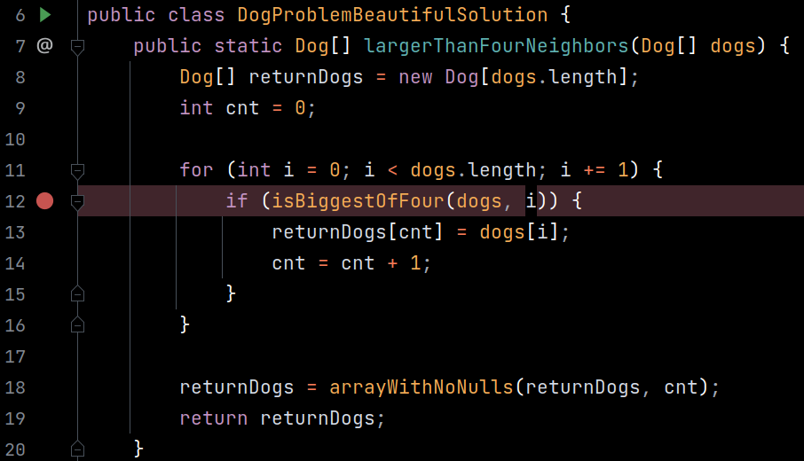
Setting Breakpoints
Breakpoints: Places in the code where the debugger will pause and let you inspect the program state
In IntelliJ:
To set/unset breakpoints, click just to the right of the line number
Breakpoints are highlighted in red
Click to launch the debugger and run the program, pausing at breakpoints

Slide 47
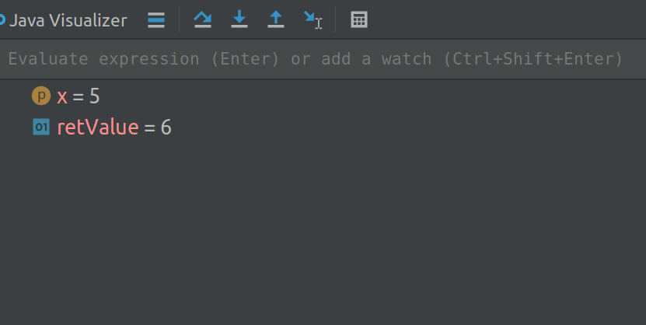
Inspecting Program State
When the program is paused, you can view the values of all the variables (as if you had added print statements)
You can also execute lines of code interactively in the "Evaluate expression" box
public static int addOne(int x) {
int retValue = x + 1;
return retValue;
}
public static void main(String[] args) {
int y = addOne(5);
System.out.println(y);
}

Slide 48


Stepping Over vs. Stepping In
IntelliJ highlights the line about to execute (has not executed yet)
If the highlighted line contains a function call:
steps over the function call, and pauses at the next line after calling the function Useful if you don't care about the code inside the function
steps into the function call, and pauses at the first line of the function Useful if you want to step through the code inside the function
public static int addOne(int x) {
int retValue = x + 1;
return retValue;
}
public static void main(String[] args) {
int y = addOne(5);
System.out.println(y);
}
Step into pauses the program here
Step over pauses the program here

Slide 49

Continue
You can set multiple breakpoints
resumes running the program, pausing at the next breakpoint encountered
public static Dog[] largerThanFourNeighbors(Dog[] dogs) {
Dog[] returnDogs = new Dog[dogs.length];
int cnt = 0;
for (int i = 0; i < dogs.length; i += 1) {
if (isBiggestOfFour(dogs, i)) {
returnDogs[cnt] = dogs[i];
cnt = cnt + 1;
}
}
returnDogs = arrayWithNoNulls(returnDogs, cnt);
return returnDogs;
}
If we're currently paused here...
will run the entire for loop, and pause the program at this breakpoint

